Slide 1
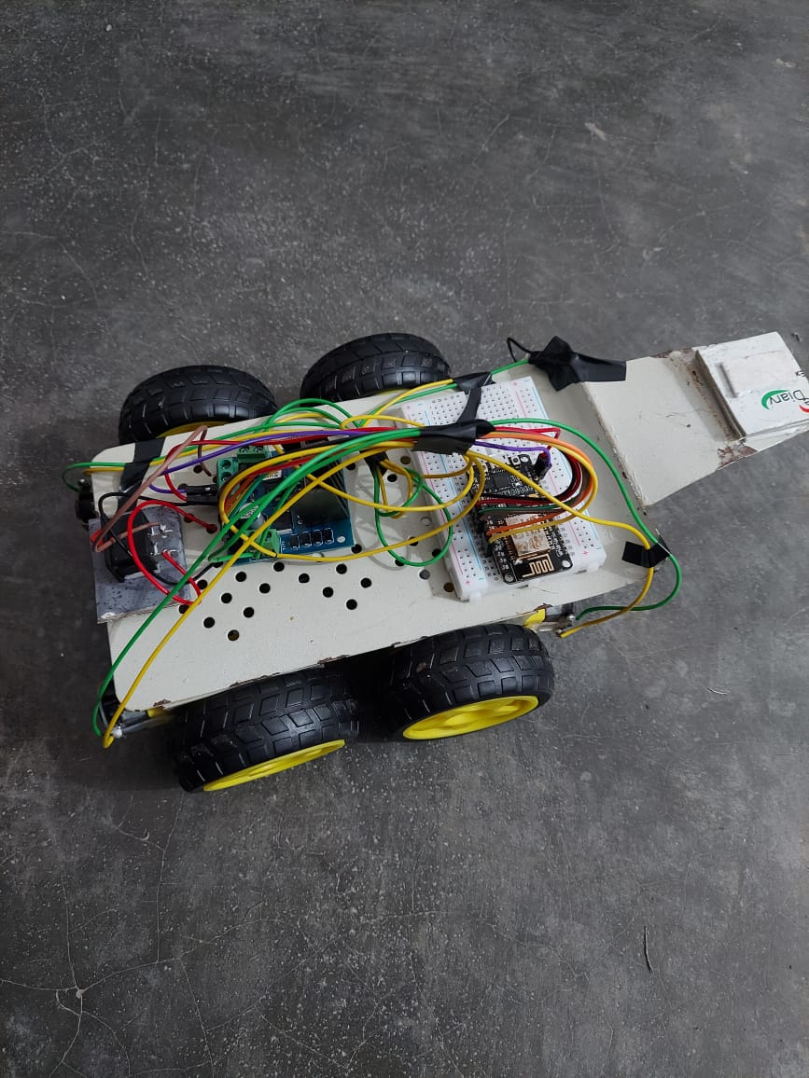
BOT - IOT
By – ANKITA AYUSHI
Mentored By –
ADITYA RAJ
AYUSHMAN DUTTA

Slide 2
INTRODUCTION
A small IOT Based car was built using an open source IOT platform , NodeMCU and Mobile application , Blynk IOT .Wifi is used for communication between the Bot and the mobile application. A motor driver is used to power the four TT Gear motors . Two 3.7 V Li-Ion cells are used to power the motor driver which further supplies power to the NodeMCU.

Slide 3
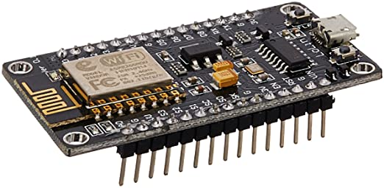
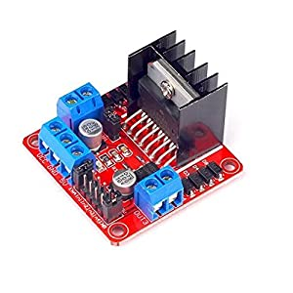
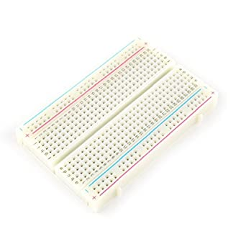
HARDWARE COMPONENTS
NodeMCU ESP8266 Wifi development board
L298N Motor Driver
4 TT Gear Motors
Breadboard
Jumper Wires
Metal Chassis
3.7V Li –Ion Batteries
Battery holder
Switch

Slide 4
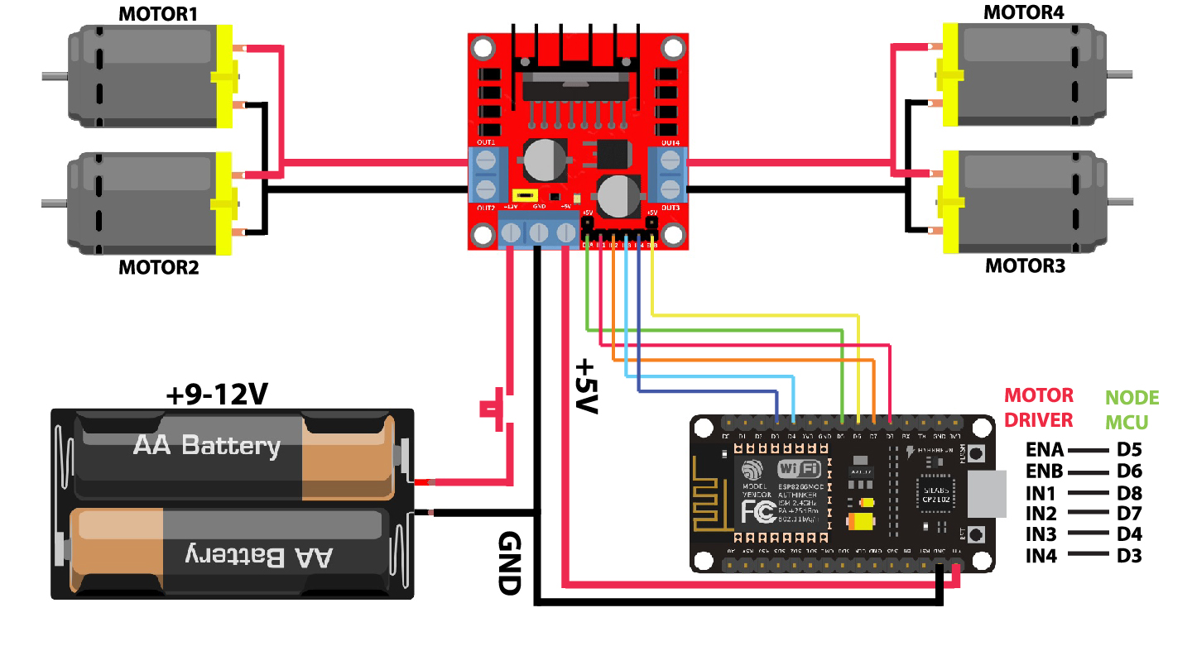
CIRCUIT DIAGRAM

Slide 5


SOFTWARE USED
ARDUINO IDE
BLYNK APP

Slide 6
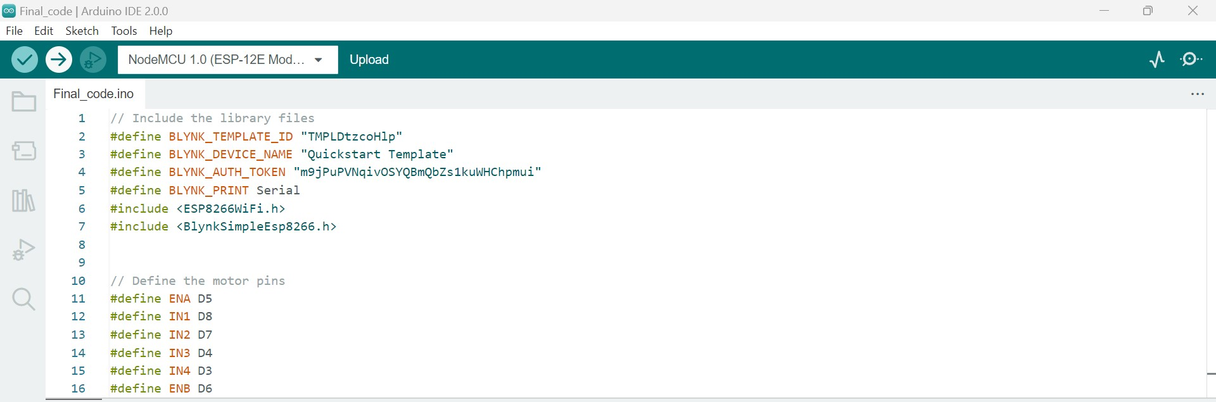
ARDUINO CODE

Slide 7
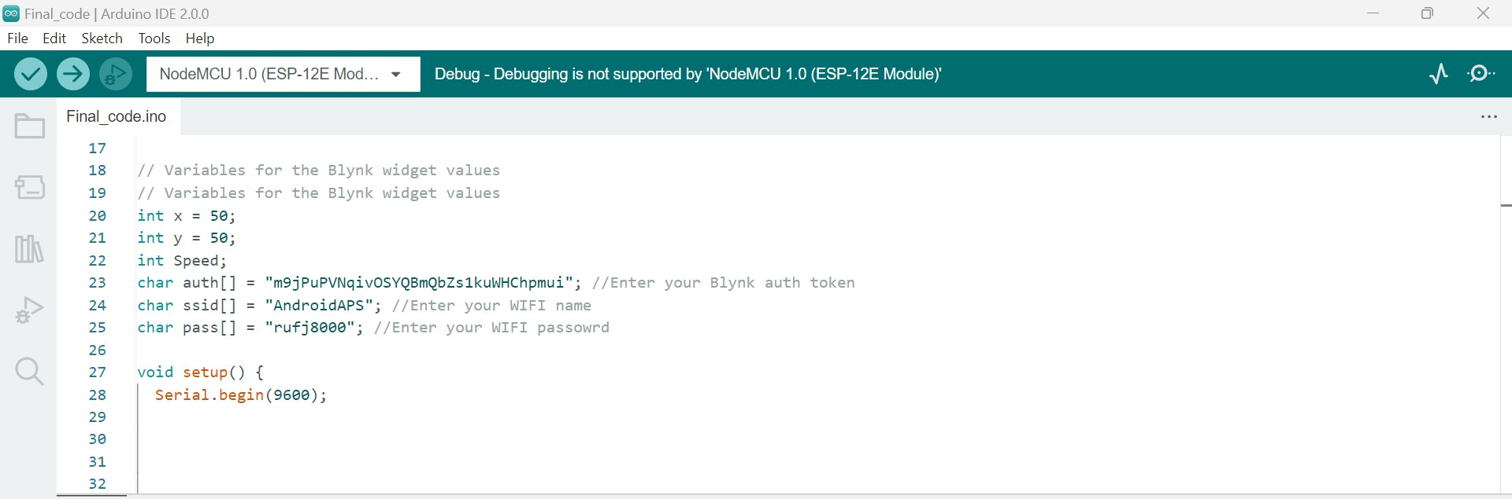
ARDUINO CODE

Slide 8
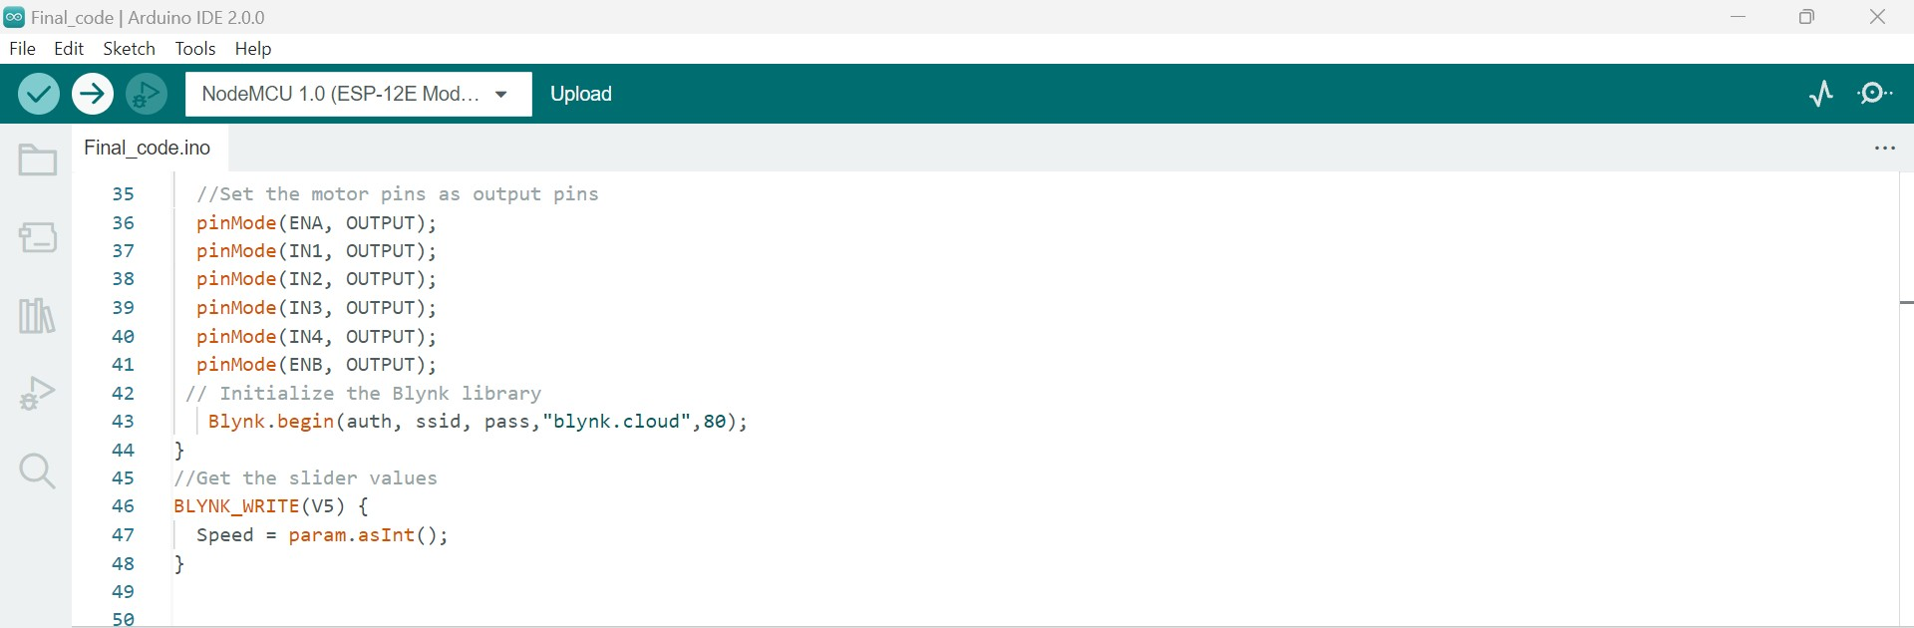
ARDUINO CODE

Slide 9
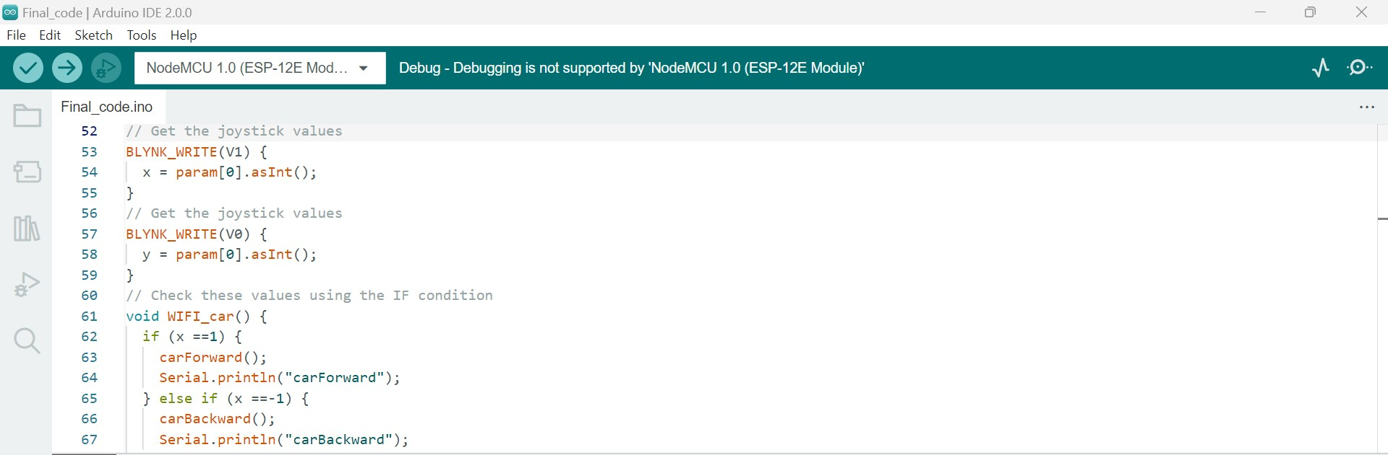
ARDUINO CODE

Slide 10
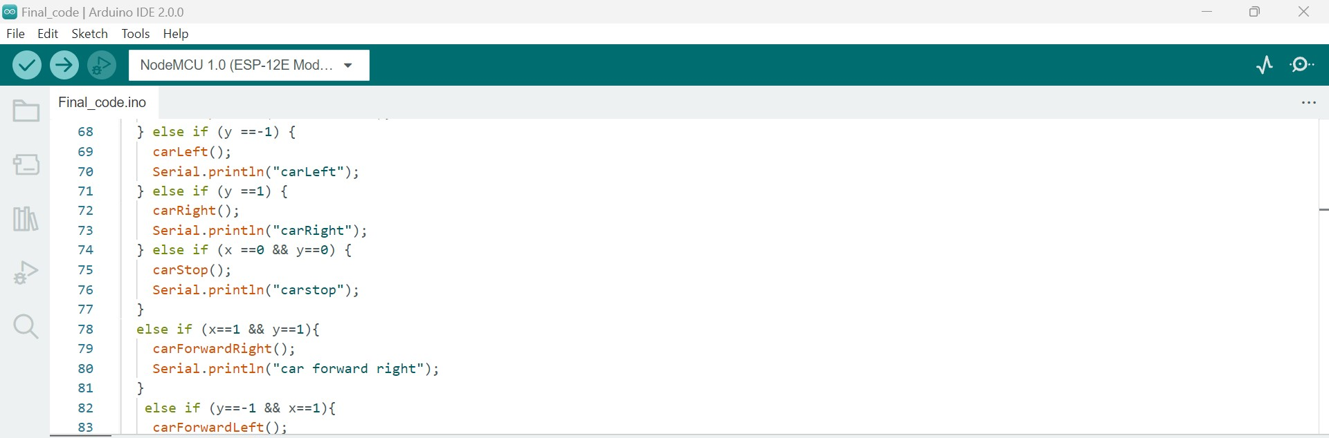
ARDUINO CODE

Slide 11
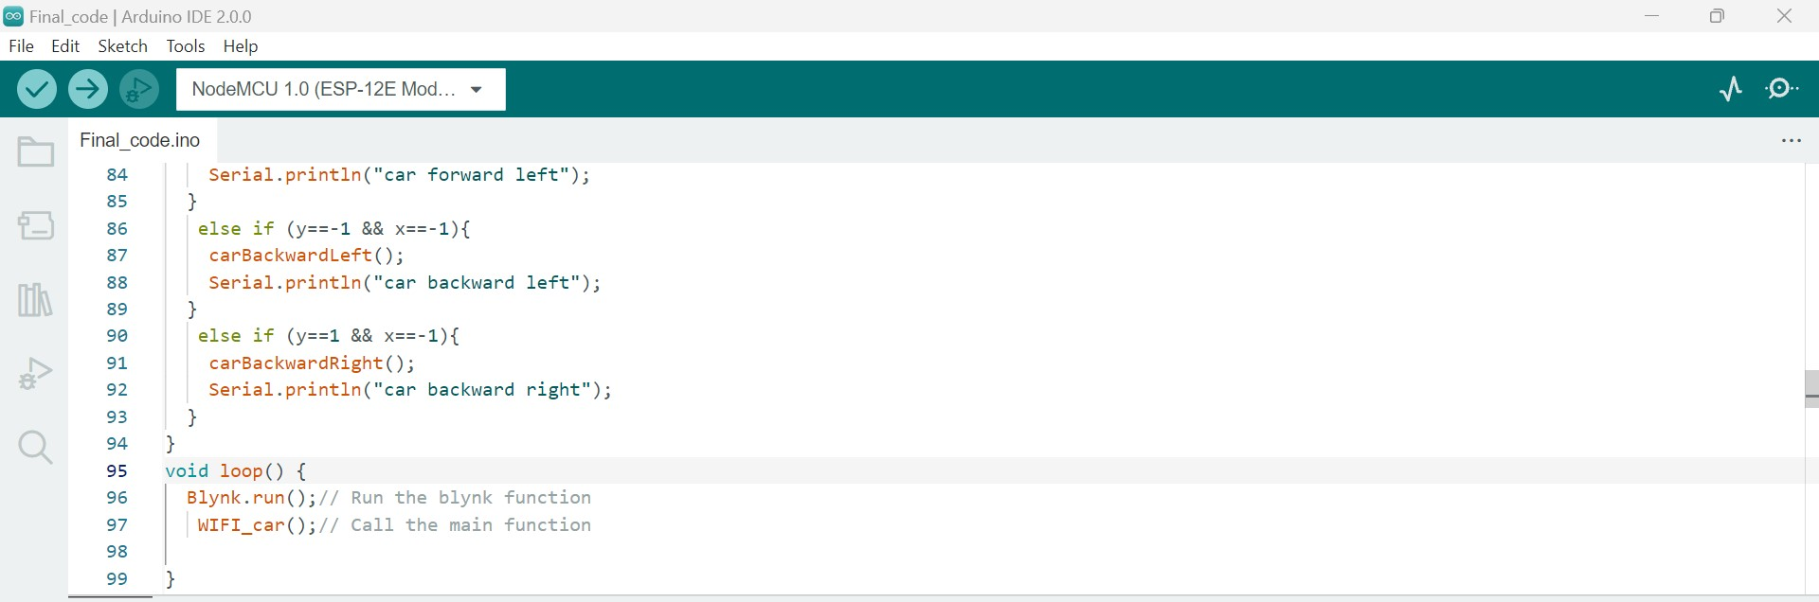
ARDUINO CODE

Slide 12
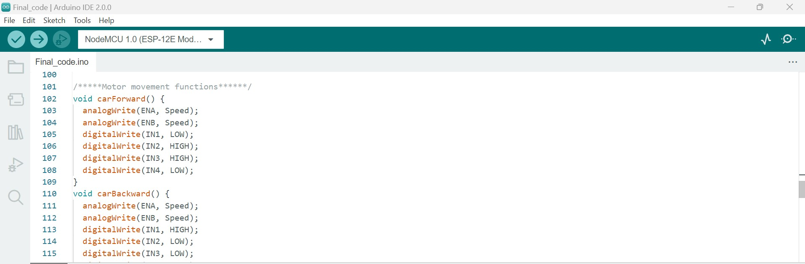
ARDUINO CODE

Slide 13

ARDUINO CODE

Slide 14

ARDUINO CODE

Slide 15
ARDUINO CODE

Slide 16
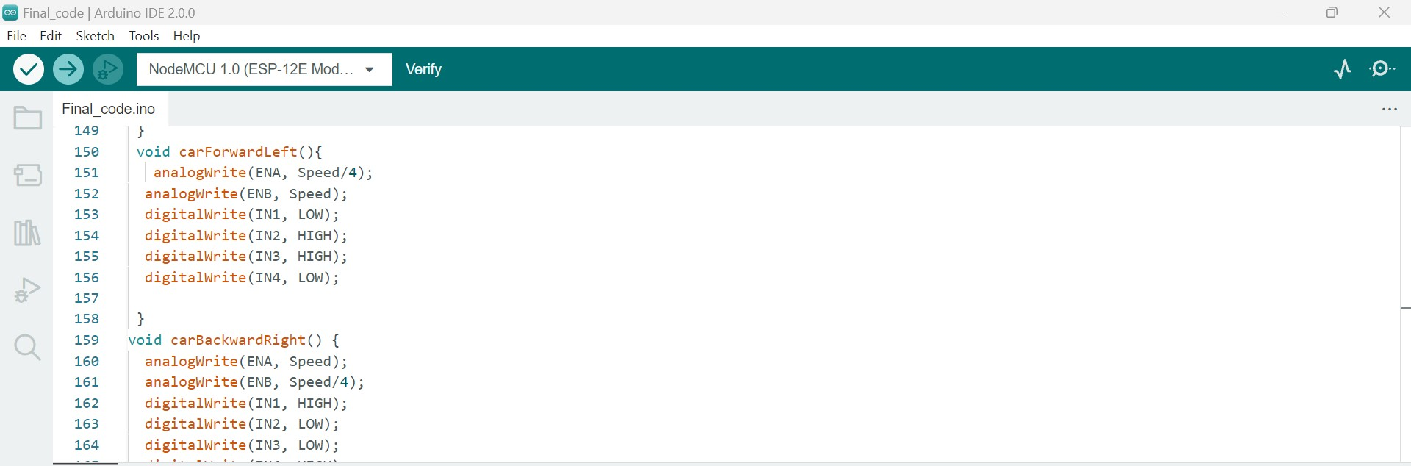
ARDUINO CODE

Slide 17
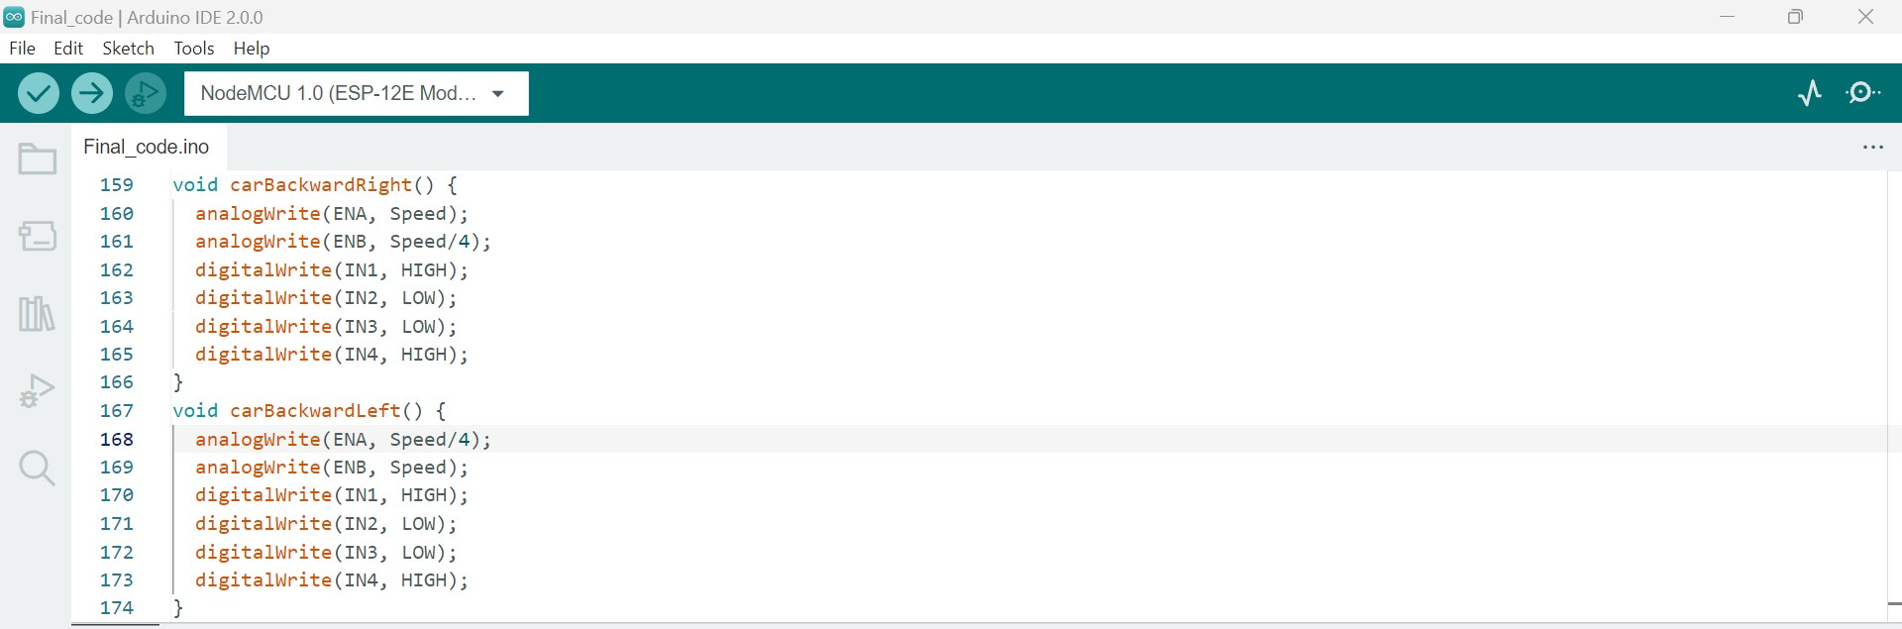
ARDUINO CODE

Slide 18
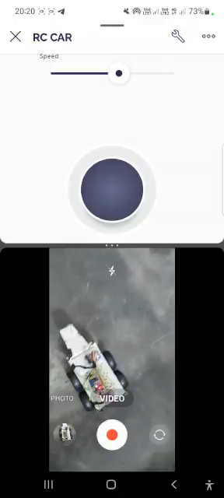
OUTPUT VIDEO

Slide 19
REFERENCES
https://www.arduino.cc/en/Tutorial/HomePage
https://www.youtube.com/watch?v=zJnDbdefeCA
https://blynk.io/en/getting-started
https://randomnerdtutorials.com/esp8266-pinout-reference-gpios/

